Slide 1
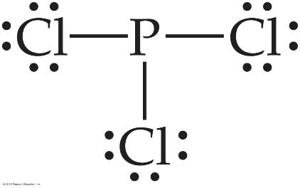
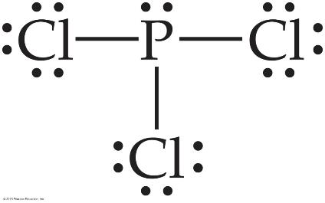
Writing Lewis Structures
Complete the octets around all atoms bonded to the central atom.
surrounding atoms first!
Keep track of the electrons:
26 − 6 = 20; 20 − 18 = 2
Place any leftover electrons on the central atom.
Keep track of the electrons:
26 − 6 = 20; 20 − 18 = 2; 2 − 2 = 0

Slide 2
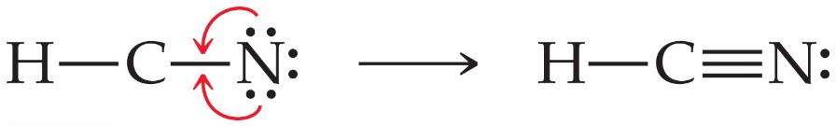
Writing Lewis Structures
5. If there are not enough electrons to give the
central atom an octet, try multiple bonds.

Slide 3
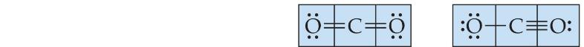
Determine Formal Charge
Assign formal charges.
Formal charge is the charge an atom would have if all of the electrons in a covalent bond were shared equally.
Formal charge = valence electrons – ½ (bonding electrons) – all nonbonding electrons
Valence Electrons 6 4 6 6 4 6
− ½ Total Bonding Electrons 2 4 2 1 4 3
− Non-Bonding Electrons 4 0 4 6 4 2
Formal Charge 0 0 0 -1 0 +1

Slide 4
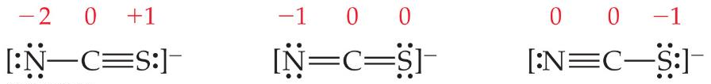
Dominant Lewis Structures
The dominant Lewis structure
is the one in which atoms have formal charges closest to zero.
puts a negative formal charge on the most electronegative atom.
Formal Charge 0 0 0 -1 0 +1
dominant
dominant

Slide 5
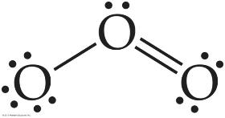
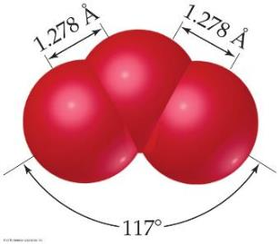
Resonance
Following our rules, this is the Lewis structure we would draw for ozone, O₃.
However, it doesn’t agree with what is observed in nature: Both O to O connections are the same.

Slide 6
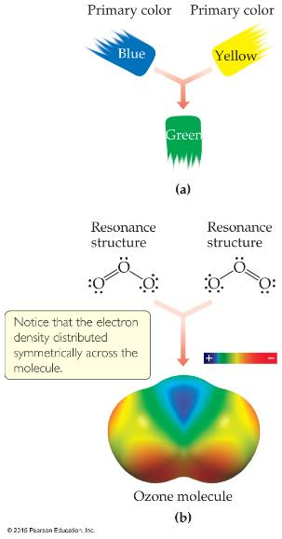
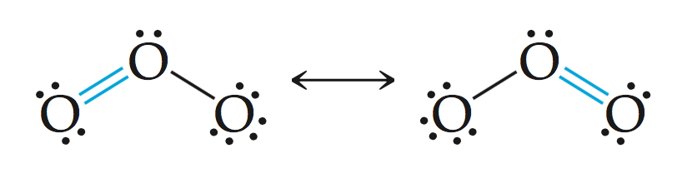
Resonance
One Lewis structure cannot accurately depict a molecule like ozone.
We use multiple structures, resonance structures, to describe the molecule.

Slide 7
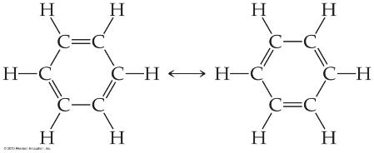

Resonance
The organic compound benzene, C₆H₆, has two resonance structures.
It is commonly depicted as a hexagon with a circle inside to signify the delocalized electrons in the ring.
Localized electrons are specifically on one atom or shared between two atoms; Delocalized electrons are shared by multiple atoms.

Slide 8
Exceptions to the Octet Rule
There are 4 types of molecules or polyatomic ions that do not follow the octet rule:
H atom needs only 2 electrons,
molecules or polyatomic ions with an odd number of electrons
molecules or polyatomic ions with less than an octet
Molecules or polyatomic ions with more than eight valence electrons (an expanded octet; 3rd and above periods because 3d orbitals are energetically accessible).

Slide 9
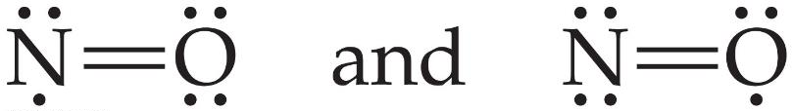
Odd Number of Electrons
Though relatively rare and usually quite unstable and reactive, there are ions and molecules with an odd number of electrons e.g. ClO₂, NO, NO₂ and O₂-

Slide 10
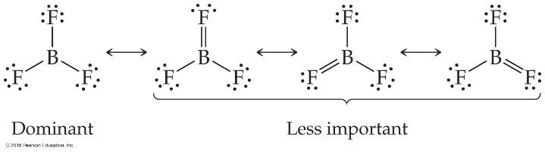
Fewer Than Eight Electrons
Elements in the second period before carbon can make stable compounds with fewer than eight electrons.
Consider BF₃:
Giving boron a filled octet places a negative charge on the boron and a positive charge on fluorine.
This would not be an accurate picture of the distribution of electrons in BF₃.
+1
0
0
-1
-1
-1
0
+1
0
+1
0
0

Slide 11
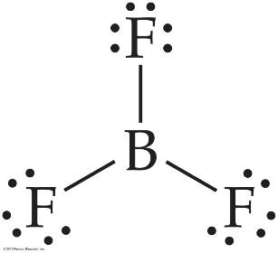
Fewer Than Eight Electrons
The lesson is: If filling the octet of the central atom results in a negative charge on the central atom and a positive charge on the more electronegative outer atom, don’t fill the octet of the central atom.

Slide 12
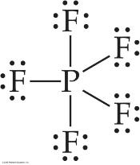
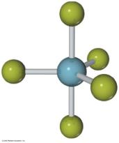
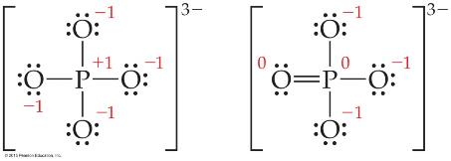
More Than Eight Electrons
When an element is in period 3 or below in the periodic table (e.g., periods 3, 4, 5, etc.), it can use d-orbitals to make more than four bonds.
Examples: PF₅ and PO₄³⁻

Slide 13
Covalent Bond Strength
The strength of a bond is measured by how much energy is required to break the bond.
This is called the bond enthalpy.
The bond enthalpy for a Cl—Cl bond, D(Cl— Cl), is measured to be 242 kJ/mol.
We write out reactions for breaking one mole of those bonds:
Cl—Cl → 2 Cl•

Slide 14
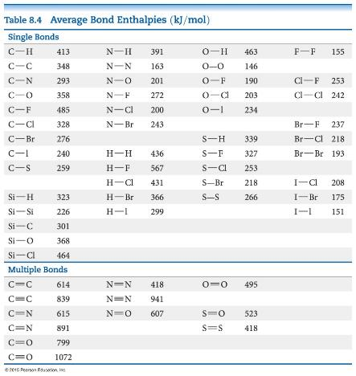
Average Bond Enthalpies
Note that these are averages over many different compounds; not every bond in nature for a pair of atoms has exactly the same bond energy.
Average bond enthalpies are positive, because bond breaking is an endothermic process.

Slide 15
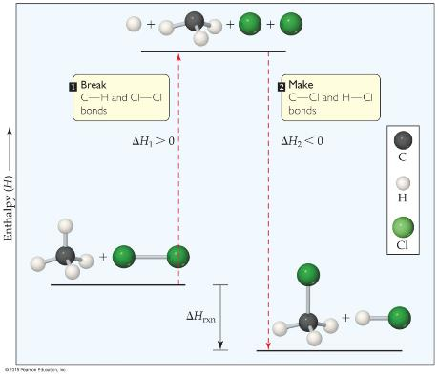
Using Bond Enthalpies to Estimate ΔH_{rxn}
One way to estimate ΔH_{rxn} is to use the bond enthalpies of bonds broken and the new bonds formed.
Energy is added to break bonds and released when making bonds.
ΔH_{rxn} = Σ(bond enthalpies of all bonds broken)
− Σ(bond enthalpies of all bonds formed).

Slide 16
Chapter 9: Molecular Geometry and Bonding Theories 化学键的方向——分子构成

Slide 17
第一部分：VSEPR Model

Slide 18
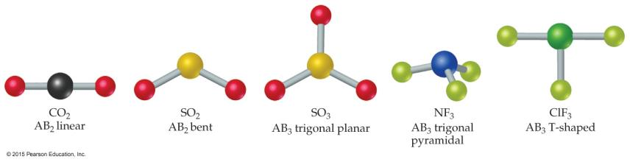
Molecular Shapes
Lewis Structures show bonding and lone pairs, but do not denote shape.
However, we use Lewis Structures to help us determine shapes.
Here we see some common shapes for molecules with two or three atoms connected to a central atom.
Common shapes of molecules with general formula AB_{n} where n is number of B atom connected to a central A atom

Slide 19
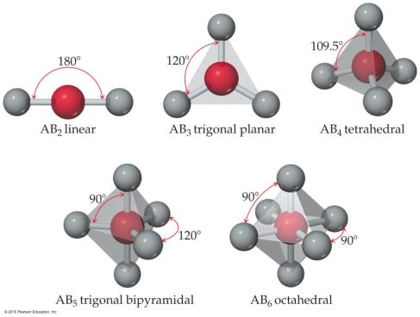
What Determines the Shape of a Molecule?
Simply put, electron pairs, whether they be bonding or nonbonding, repel each other.
By assuming the electron pairs are placed as far as possible from each other, we can predict the shape of the molecule.
This is the Valence-Shell Electron-Pair Repulsion (VSEPR) model.

Slide 20

Valence-Shell Electron-Pair Repulsion (VSEPR) Model
“The best arrangement of a given number of electron domains is the one that minimizes the repulsions among them.”
(The balloon analogy in the figure to the left demonstrates the maximum distances, which minimize repulsions.)

Slide 21
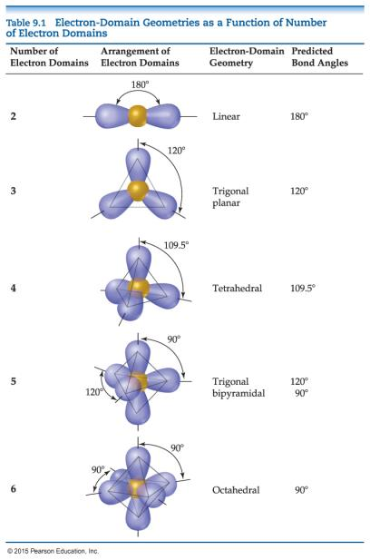
Electron-Domain Geometries
The Table shows the electron-domain geometries for two through six electron domains around a central atom.
To determine the electron-domain geometry, count the total number of lone pairs, single, double, and triple bonds on the central atom.

Slide 22
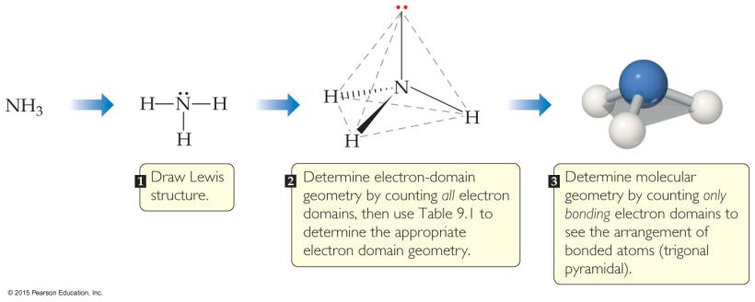
Molecular Geometries
Once you have determined the electron-domain geometry, use the arrangement of the bonded atoms to determine the molecular geometry.
Tables 9.2 and 9.3 show the potential molecular geometries. We will look at each electron domain to see what molecular geometries are possible.

Slide 23
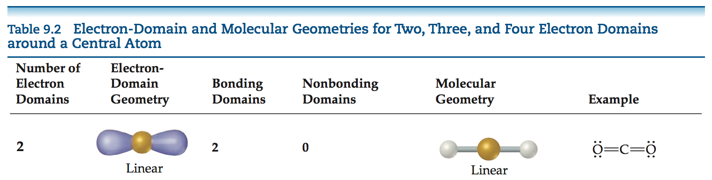
Linear Electron Domain
In the linear domain, there is only one molecular geometry: linear.
NOTE: If there are only two atoms in the molecule, the molecule will be linear no matter what the electron domain is.

Slide 24
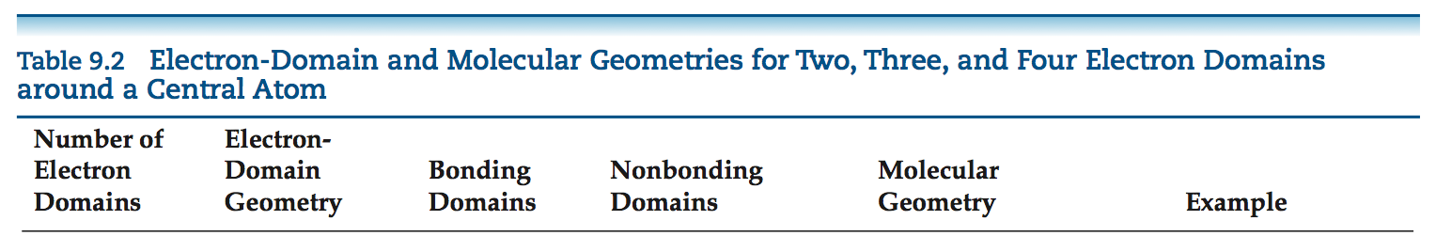
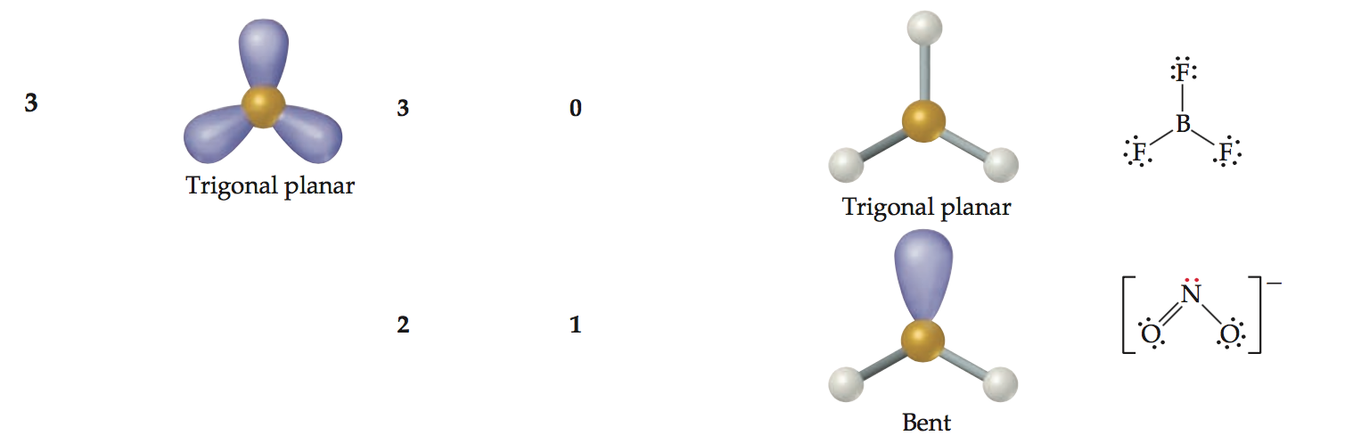
Trigonal Planar Electron Domain
There are two molecular geometries:
trigonal planar, if all electron domains are bonding, and
bent, if one of the domains is a nonbonding pair.

Slide 25
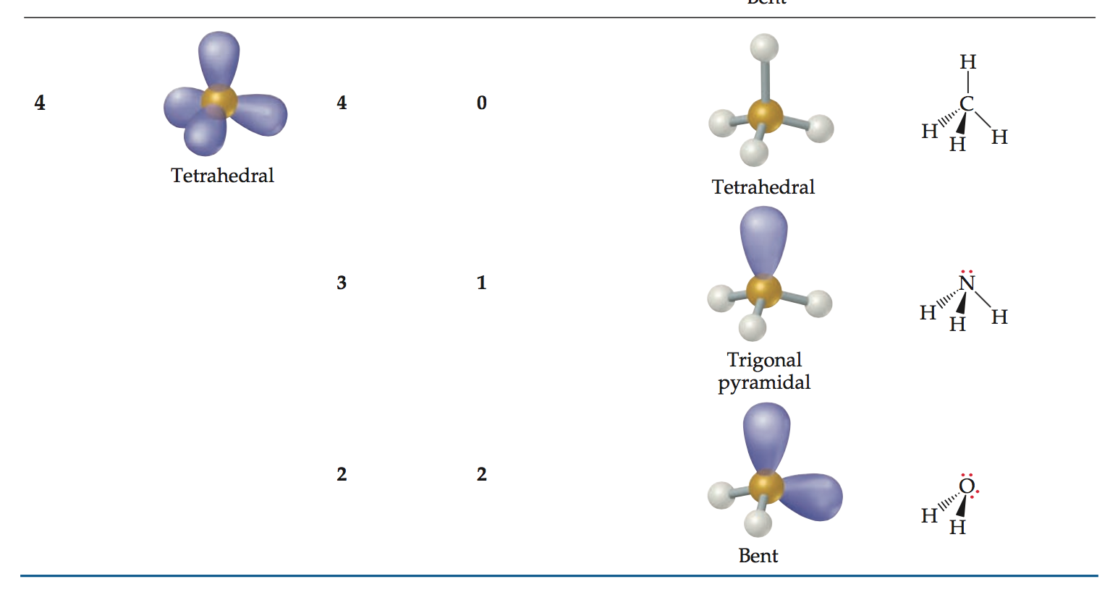
Tetrahedral Electron Domain
There are three molecular geometries:
tetrahedral, if all are bonding pairs,
trigonal pyramidal, if one is a nonbonding pair, and
bent, if there are two nonbonding pairs.

Slide 26
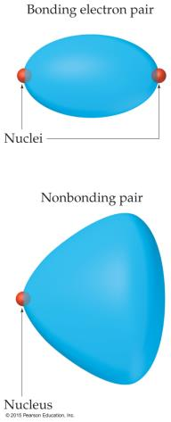
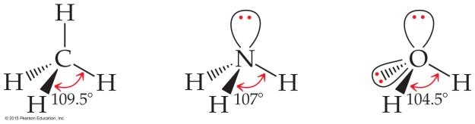
Nonbonding Pairs and Bond Angle
Nonbonding pairs are physically larger than bonding pairs.
Therefore, their repulsions are greater; this tends to compress bond angles.

Slide 27
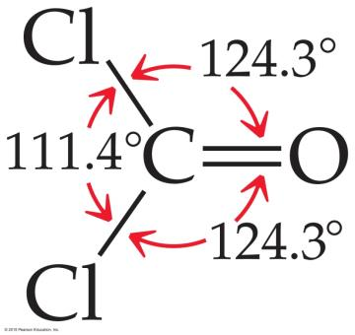
Multiple Bonds and Bond Angles
Double and triple bonds have larger electron domains than single bonds.
They exert a greater repulsive force than single bonds, making their bond angles greater.

Slide 28
Expanding beyond the Octet Rule
Remember that some elements can break the octet rule and make more than four bonds (or have more than four electron domains).
The result is two more possible electron domains: five = trigonal bipyramidal; six = octahedral (as was seen in the slide on electron-domain geometries).

Slide 29
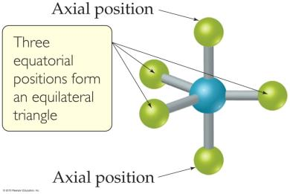
Trigonal Bipyramidal Electron Domain
There are two distinct positions in this geometry:
Axial
Equatorial
Lone pairs occupy equatorial positions.

Slide 30
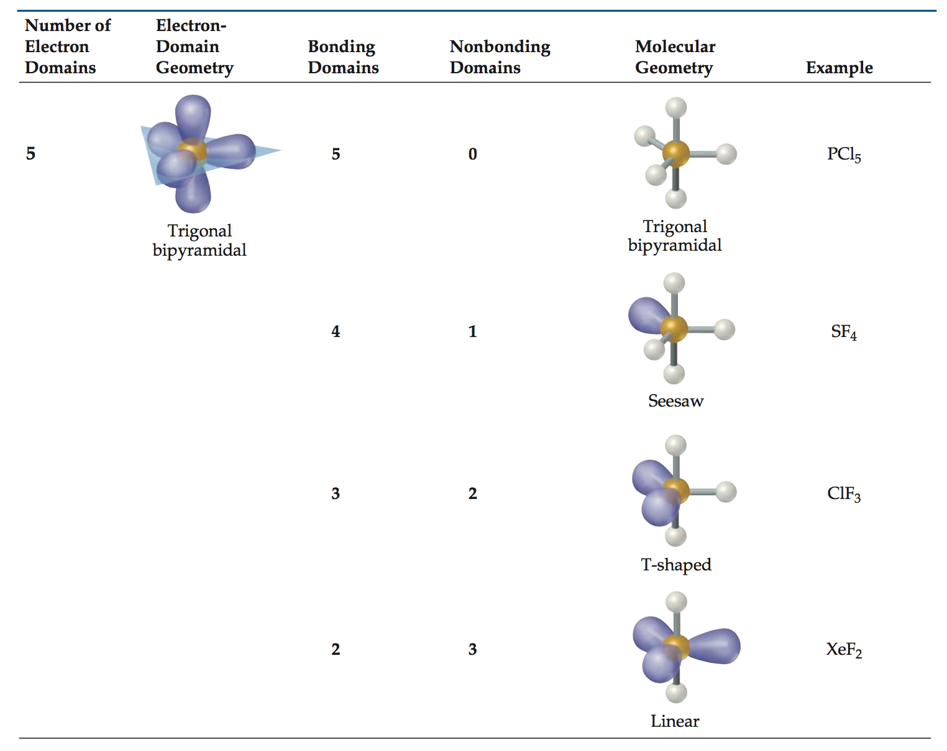
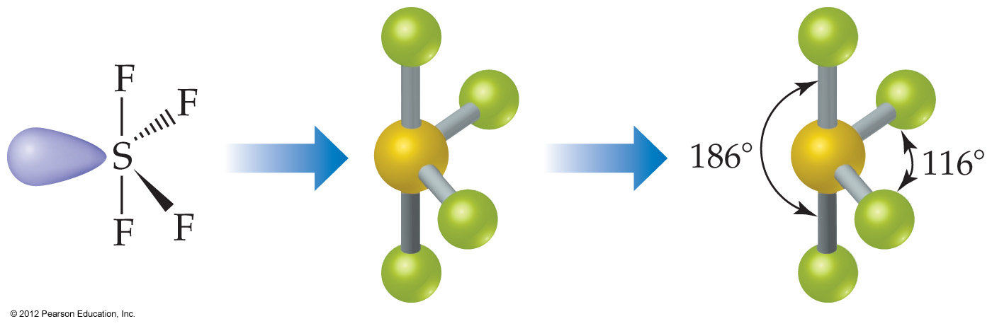
Trigonal Bipyramidal Electron Domain
There are four distinct molecular geometries in this domain:
> Trigonal bipyramidal
> Seesaw
> T-shaped
Linear

Slide 31
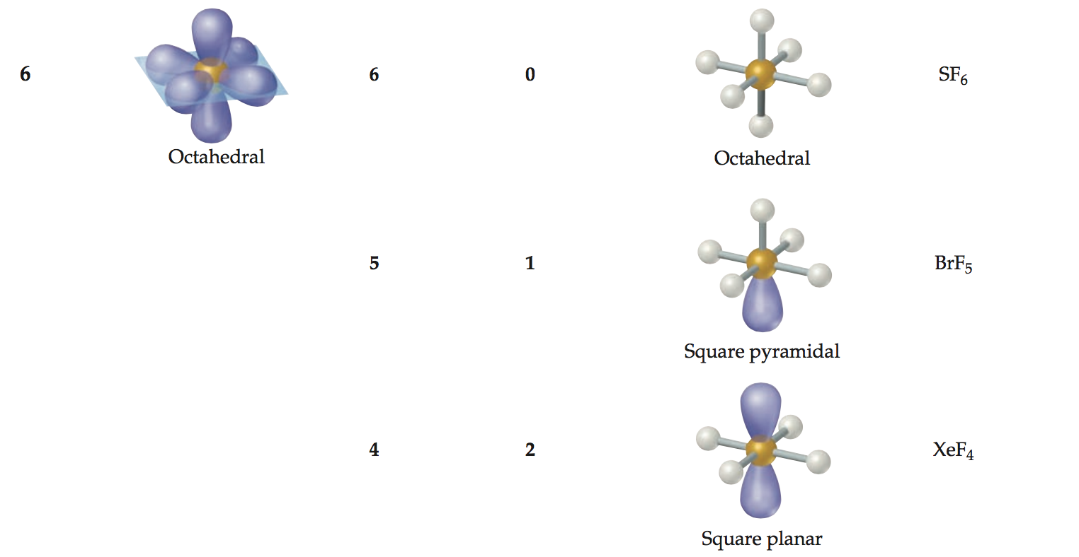
Octahedral Electron Domain
All positions are equivalent in the octahedral domain.
There are three molecular geometries:
Octahedral
Square pyramidal
Square planar

Slide 32
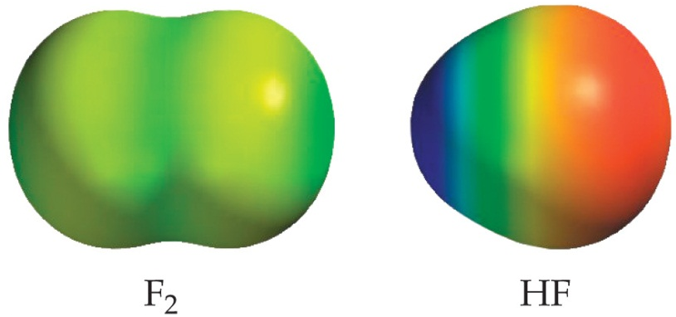
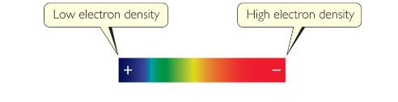
Polar Covalent Bonds
The electrons in a covalent bond are not always shared equally.
Bond polarity - measurement of how equally or unequally the electrons in any covalent bond are share.
Fluorine pulls harder on the electrons it shares with hydrogen than hydrogen does.
Therefore, the fluorine end of the molecule has more electron density than the hydrogen end.

Slide 33
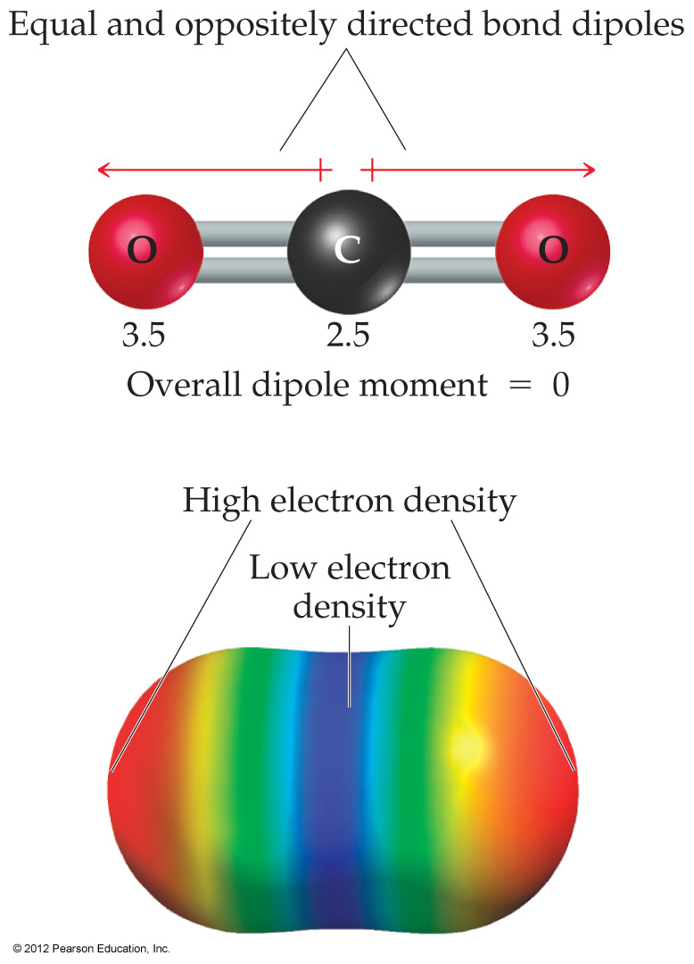
Polarity
In Chapter 8, we discussed dipoles moment.
Bond dipole: the dipole moment due only to the two atoms in that bond
A molecule possesses polar bonds does not mean the molecule as a whole will be polar.

Slide 34
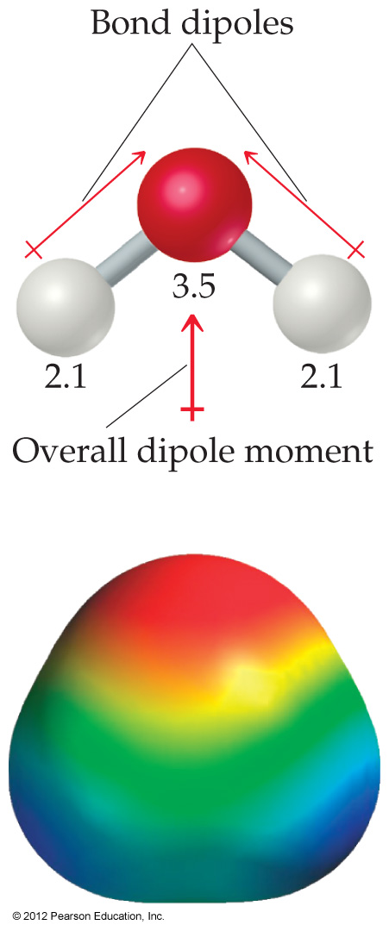
Molecular Polarity
Bond dipoles and dipole moments are vector quantities.
By adding the individual bond dipoles, one can determine the overall dipole moment for the molecule.
O
H
H

Slide 35
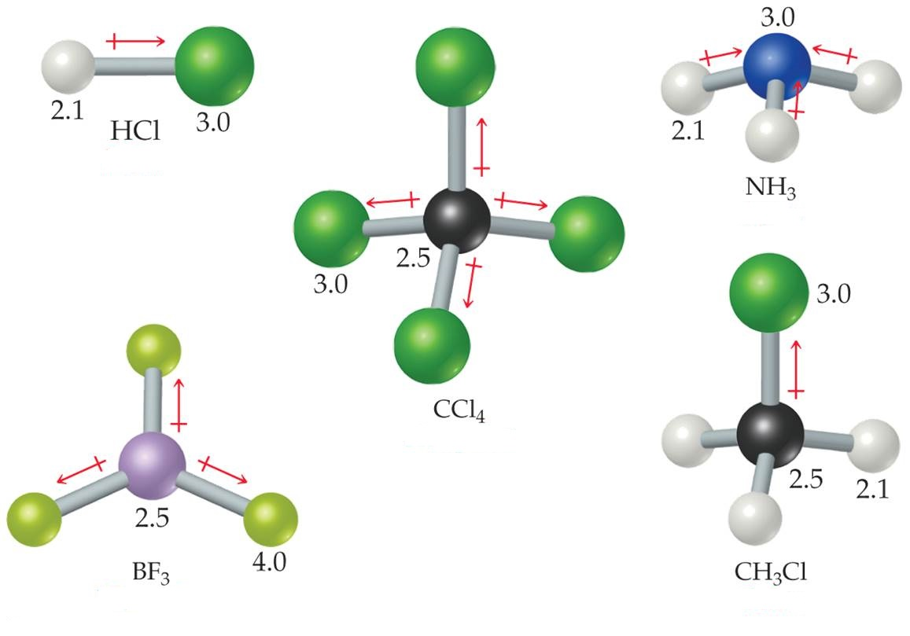
Molecular Polarity
Polar
Polar
Nonpolar
Polar
Nonpolar

Slide 36
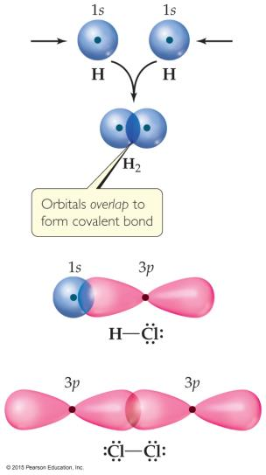
Valence-Bond Theory
In Valence-Bond Theory, electrons of two atoms begin to occupy the same space.
This is called “overlap” of orbitals.
The sharing of space between two electrons of opposite spin results in a covalent bond.

Slide 37
第二部分：Hybrid Orbitals

Slide 38
Hybrid Orbitals
Hybrid orbitals form by “mixing” of atomic orbitals to create new orbitals of equal energy, called degenerate orbitals.
When two orbitals “mix” they create two orbitals; when three orbitals mix, they create three orbitals; etc.

Slide 39
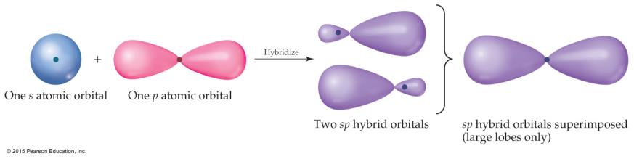
sp Orbitals
Mixing the s and p orbitals yields two degenerate orbitals that are hybrids of the two orbitals.
These sp hybrid orbitals have two lobes like a p orbital.
One of the lobes is larger and more rounded, as is the s orbital.

Slide 40
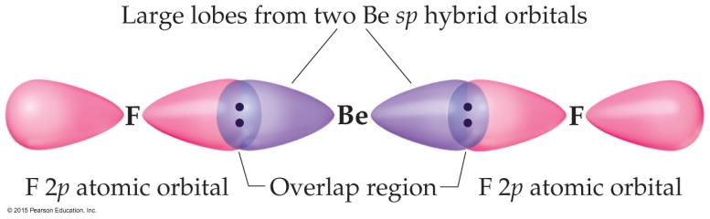

Position of sp Orbitals
These two degenerate orbitals would align themselves 180° from each other.
This is consistent with the observed geometry of Be compounds (like BeF₂) and VSEPR: linear.

Slide 41
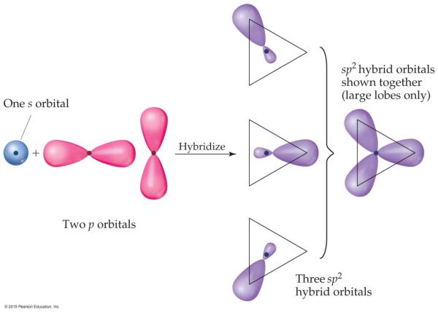
Three Electron Domains Gives sp² Hybridization
For BF_{3,} using a similar model for boron leads to three degenerate sp² orbitals.
Trigonal planar geometry

Slide 42
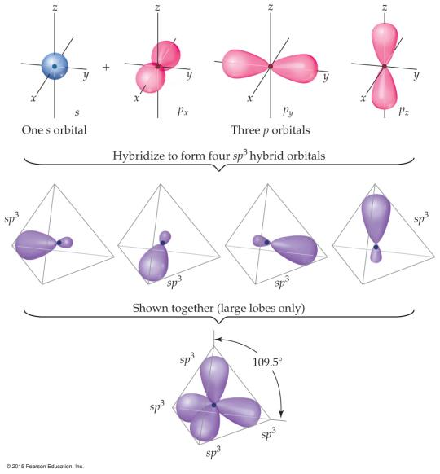
Carbon: sp³ Hybridization
With carbon, we get four degenerate sp³ orbitals.
Tetrahedral geometry

Slide 43
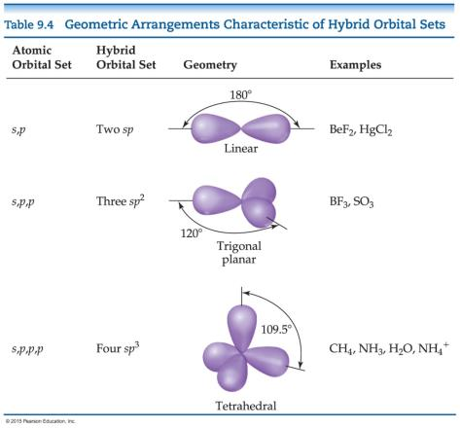
Hybrid Orbital Summary
Draw the Lewis structure.
Determine the # of Electron domains
Find the combination of orbitals for hybridization (s + # of p orbitals) from the same atom.
2 e-domains => s+1 p = sp
3 e-domains => s+2 p’s = sp²
4 e-domains => s+3 p’s = sp³
Arrangement of hybrid orbitals follows the rule for electron-domain geometry

Slide 44
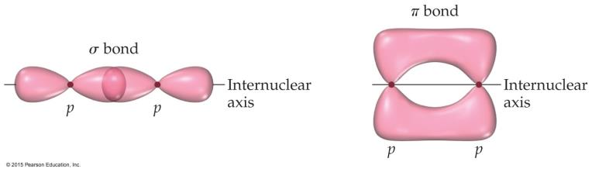
Sigma (σ) and Pi (π) Bonds
Sigma bonds are characterized by
head-to-head overlap.
cylindrical symmetry of electron density about the internuclear axis.
Pi bonds are characterized by
side-to-side overlap.
electron density above and below the internuclear axis.

Slide 45
Localized or Delocalized Electrons
Bonding electrons (σ or π) that are specifically shared between two atoms are called localized electrons.
In many molecules, we can’t describe all electrons that way (resonance); the other electrons (shared by multiple atoms) are called delocalized electrons.
We have to view the molecule as a whole, including all (not just the valence) electrons!

Slide 46
第三部分：MO

Slide 47
Electron configurations and molecular properties
Paramagnetism (顺磁性):Molecules with one or more unpaired electrons are attracted to a magnetic filed.顺磁性是一种弱磁性。当分子轨道或原子轨道 上有落单的电子时，就会产生顺磁性。
Diamagnetism(反磁性): Substance with no unpaired
electrons are weekly repelled by magnetic field.
Lewis structure for O₂ shows a double bond and complete pairing of electrons;
Together with valence bond theory, both can not explain the
Paramagnetism of O₂.

Slide 48
Molecular Orbitals
Molecular orbitals result from the combination of atomic orbitals.
Since orbitals are wave functions, they can combine either constructively (forming a bonding molecular orbital), or destructively (forming an antibonding molecular orbital).

Slide 49
Molecular Orbitals
Molecular orbitals form when atomic orbitals with similar energies and proper symmetry can overlap. 门 当 户 对
Atomic orbitals with differing energies or the wrong spatial orientation (orthogonal) do not combine, and are called non-bonding orbitals.

Slide 50
Forming Molecular Orbitals
Atomic Orbitals (s, p, d, f…) are pictorial representations of solutions to the quantum mechanical equations describing electron locations in atoms.
A wave function is a solution to the quantum mechanical equation.
We use ψ to represent a given wave function.
The orbitals are actually pictures of ψ² functions.
（第六章内容）

Slide 51
Linear Combinations of Atomic Orbitals (LCAO’s)
Molecular Orbitals are formed by combining AO’s:
ψ = c_{a}ψ_{a} + c_{b}ψ_{b}
ψ = a molecular wave function
ψ_{a} = an atomic wave function from atom A c = constant that can be + or –

Slide 52
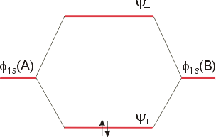
Molecular Orbital Theory
The result is an energy level diagram with the bonding orbital occupied by a pair of electrons. The filling of the lower molecular orbital indicates that the molecule is stable compared to the two individual atoms.

Slide 53
Rules for Combining Atomic Orbitals
The number of molecular orbitals =
the number of atomic orbitals combined.
The strength of the bond depends upon the degree of orbital overlap.

Slide 54
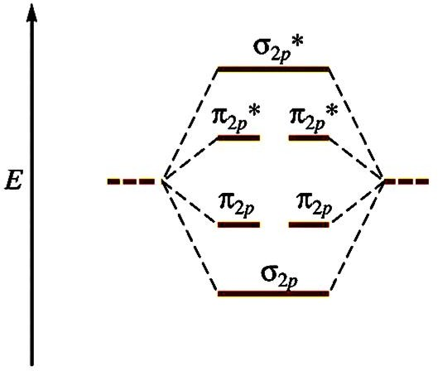
Molecular Orbital Diagram
This is a molecular orbital energy level diagram for the p orbitals. Note that the σ bonding orbital is lowest in energy due to the greater overlap end-on-end.

Slide 55
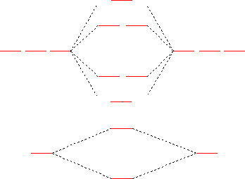
MO Diagram for O₂

Slide 56
Bond Order
Bond order is an indicator of the bond strength and length. A bond order of 1 is equivalent to a single bond. Fractional bond orders are possible.
The bond order of the molecule =
[(# e⁻ in bonding orbitals) - (# e⁻ in anti-bonding orbitals)]/2

Slide 57
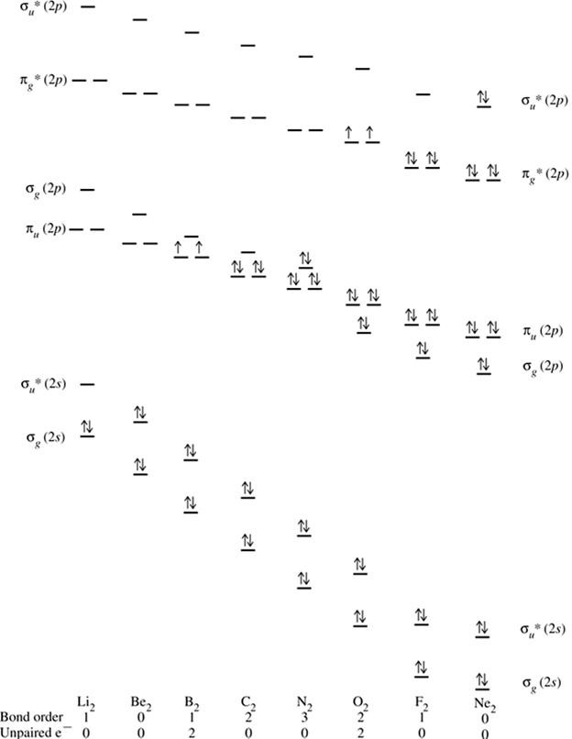

Slide 58
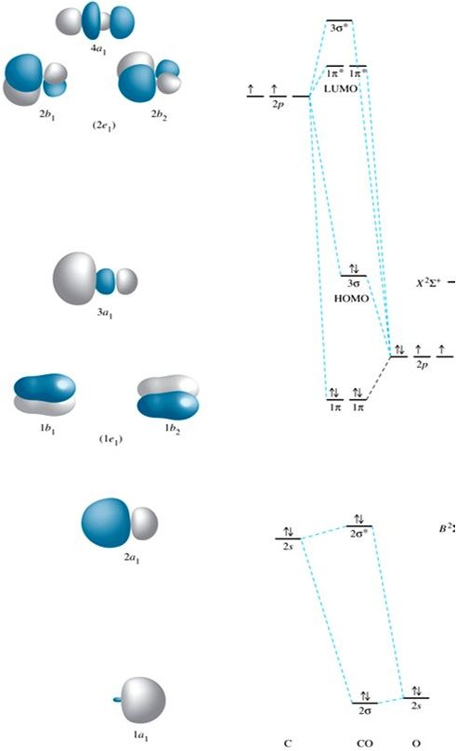


Slide 59


Slide 60
Chapter 11: Liquids and Intermolecular Forces

Slide 61
Types of Intermolecular Force
Weakest to strongest forces:
dispersion forces (or London dispersion forces) 色散力
dipole–dipole forces 静电力
hydrogen bonding (a special dipole–dipole force)
ion–dipole forces
Note: The first two types are also referred to collectively as van der Waals forces.
色散力（伦敦力）
偶极-偶极力 （注：有时有分成静电力和诱导力）
氢键（特殊的偶极-偶极力）
离子偶极力
注：前两种类型也统称为范德华力。

Slide 62
Intermolecular Forces VS Intramolecular Forces

Slide 63
Liquid Properties Affected by Intermolecular Forces
boiling point (previously discussed) and melting point
viscosity
surface tension
capillary action

Slide 64
Colligative Properties
Colligative properties depend only on the quantity, not on the identity of the solute particles.
Among colligative properties are:
Vapor-pressure lowering
Boiling-point elevation
Freezing-point depression
Osmotic pressure

Slide 65
Chapter 5: Thermochemistry 热化学

Slide 66
energy changes in chemical reactions

Slide 67

Definitions: System and Surroundings
The system includes the molecules we want to study (here, the hydrogen and oxygen molecules).
The surroundings are everything else (here, the cylinder and piston).

Slide 68

First Law of Thermodynamics
Energy is neither created nor destroyed.
In other words, the total energy of the universe is a constant; if the system loses energy, it must be gained by the surroundings, and vice versa.
Internal Energy：ΔE = E_{final} − E_{initial}
ΔE > 0, E_{final} > E_{initial} endergonic
ΔE < 0, E_{final} < E_{initial} ex ergonic

Slide 69

Exchange of Heat between System and Surroundings
When heat is absorbed by the system from the surroundings, the process is endothermic (enter).
When heat is released by the system into the surroundings, the process is exothermic (exit).

Slide 70
State Functions
Therefore, internal energy is a state function.
It depends only on the present state of the system, not on the path by which the system arrived at that state.
And so, ΔE depends only on E_{initial} and E_{final}.

Slide 71
Enthalpy
If a process takes place at constant pressure (as the majority of processes we study do) and the only work done is pressure–volume work, we can account for heat flow during the process by measuring the enthalpy of the system.
Enthalpy is the internal energy plus the product of pressure and volume:
H = E + PV

Slide 72
Enthalpy
Since ΔE = q + w and if under constant pressure, w = −PΔV, we can substitute these into the above expression:
ΔE = q_{p} - PΔV
q_{p} = Δ(E + PV)
q_{p} = ΔH， H= E+PV
H must be a state function.
At constant pressure, the amount of enthalpy change (ΔH) is the same as the heat (q_{p}) gained or lost.

Slide 73

Endothermicity Exothermicity
A process is endothermic when ΔH is positive.
A process is exothermic when ΔH is negative.

Slide 74

Enthalpy of Reaction
The change in enthalpy, ΔH, is the enthalpy of the products (final state) minus the enthalpy of the reactants (initial state):
ΔH = H_{products} − H_{reactants}

Slide 75
The Truth about Enthalpy
Enthalpy is an extensive property.
ΔH for a reaction in the forward direction is equal in size, but opposite in sign, to ΔH for the reverse reaction.
ΔH for a reaction depends on the state of the products and the state of the reactants.

Slide 76

Calorimetry (method) – calorimeter (device)
Since we cannot know the absolute amount of enthalpy of the reactants or the products, we measure ΔH through calorimetry, which is the measurement of heat flow.

Slide 77
Heat Capacity and Specific Heat
Heat capacity is
heat transferred
heat capacity =
temperature change
Specific heat, then, is
heat transferred
Specific heat =
mass × temperature change
q
s =
m × ΔT

Slide 78
Constant Pressure Calorimetry
Because the specific heat for water is well known (4.184 J/g-K), we can measure ∆H for the reaction with this equation:
q = m * s *∆T
Specific heat

Slide 79

Bomb Calorimetry (fixed volume but not pressure)
Reactions can be carried out in a sealed “bomb” such as this one.
The heat absorbed (or released) by the water is a very good approximation of the enthalpy change for the reaction.

Slide 80
Bomb Calorimetry
Because the volume in the bomb calorimeter is constant, what is measured is really the change in internal energy, ΔE, not ΔH.
ΔE = q + w
ΔE = q_{v} + 0 (if constant V)
ΔE = q_{v}
ΔH = Δ(E+PV) = ΔE + Δ(PV)
= ΔE + (P_{f}V_{f} - P_{i}V_{i})
For most reactions, the difference is very small.

Slide 81
Enthalpies of Formation (ΔH_{f})
An enthalpy of formation, ΔH_{f}, is defined as the enthalpy change for the reaction in which 1 mole of a compound is made from its constituent elements in their elemental forms.
Not ANY reaction, but a specific type – formation reaction.

Slide 82
Standard Enthalpies of Formation
Standard enthalpies of formation, ΔH_{f}º, are measured under standard conditions (25 ºC and 1.00 atm pressure).
By definition, the standard enthalpy of formation of the most stable form of any element is zero because there is no formation reaction needed when the element is already in its standard state.
Thus, the values of ΔH_{f}º for C(graphite), H₂(g), O₂(g), and the standard states of other elements are zero by definition.

Slide 83
Hess’s Law
ΔH is available or known for many reactions, and it is inconvenient to measure ΔH for every reaction in which we are interested.
However, we can estimate ΔH of MANY reactions yet to be tested by using ΔH values that are already known.
from known reactions to unknown reactions

Slide 84

Hess’s Law
Because ΔH is a state function, the total enthalpy change depends only on the initial state of the reactants and the final state of the products.
“if a reaction is carried out in a series of steps, ΔH for the overall reaction will be equal to the sum of the enthalpy changes for the individual steps.”
CH₄(g) + 2O₂(g) ⎯→ 3CO₂(g) + 2H₂O(l)
CH₄(g) + (3/2)O₂(g) ⎯→ CO(g) + 2H₂O(l)
CO(g) + (1/2)O₂(g) ⎯→ 3CO₂(g) + 2H₂O(l)

Slide 85
Calculation of ΔH from Enthalpies of Formation
We can use Hess’s law in this way:
ΔH = ΣnΔH_{f}º_{,products} – ΣmΔH_{f}º_{,reactants}
where n and m are the stoichiometric coefficients.
Standard enthalpies of formation, ΔH_{f}º, are measured under standard conditions (25 ºC and 1.00 atm pressure).

Slide 86
Bond Enthalpies
Chemical Energy
Breaking old bond(s) in the reactants
while making new bond(s) in the products
Bond enthalpy values given in chemical data books are averaged values.
ΔH = ∑ ΔH_{(bonds broken)} - ∑ ΔH_{(bonds formed)}

Slide 87

Lecture Presentation
Chapter 14 Chemical Kinetics
James F. Kirby
Quinnipiac University
Hamden, CT

Slide 88
Factors that Affect Reaction Rates
Physical state of the reactants
Reactant concentrations
Reaction temperature
Presence of a catalyst

Slide 89
Reaction Rate
Rate is a change in concentration over a time period: Δ[ ]/Δt.
Δ means “change in.”
[ ] means molar concentration.
t represents time.
Types of rate measured:
average rate
instantaneous rate
initial rate

Slide 90

Plotting Rate Data
A plot of the data gives more information about rate.
The slope of the curve at one point in time gives the instantaneous rate.
The instantaneous rate at time zero is called the initial rate; this is often the rate of interest to chemists.
This figure shows instantaneous and initial rate of the earlier example.
Note: Reactions typically slow down over time!

Slide 91

An Example of How Concentration Affects Rate
Experiments 1–3 show how [NH₄⁺] affects rate.
Experiments 4–6 show how [NO₂⁻] affects rate.
Result: The rate law, which shows the relationship between rate and concentration for all reactants:
Rate = k [NH₄⁺] [NO₂⁻]

Slide 92

Molecularity
The molecularity of an elementary reaction tells how many molecules are involved in that step of the mechanism.

Slide 93
More about Rate Law
The exponents tell the order of the reaction with respect to each reactant.
In our example from the last slide:
Rate = k [NH₄⁺] [NO₂⁻]
The order with respect to each reactant is 1. (It is first order in NH₄⁺ and NO₂⁻.)
The reaction is second order (1 + 1 = 2; we just add up all of the reactants’ orders to get the reaction’s order).
What is k? It is the rate constant. It is a temperature-dependent quantity.

Slide 94
First Order Reactions
Some rates depend only on one reactant to the first power.
These are first order reactions.
The rate law becomes:
Rate = k [A]

Slide 95
Relating k to [A] in a First Order Reaction
rate = k [A]
rate = −Δ [A] / Δt
So: k [A] = −Δ [A] / Δt
Rearrange to: Δ [A] / [A] = − k Δt
Integrate: ln ([A] / [A]_{o}) = − k t
Rearrange: ln [A] = − k t + ln [A]_{o}
Note: this follows the equation of a line: y = m x + b
So, a plot of ln [A] vs. t is linear.

Slide 96

Half-life
Definition: The amount of time it takes for one-half of a reactant to be used up in a chemical reaction.
First Order Reaction:
ln [A] = − k t + ln [A]_{o}
ln ([A]_{o}/2) = − k t_{½} + ln [A]_{o}
− ln ([A]_{o}/2) + ln [A]_{o} = k t_{½}
ln ([A]_{o} / [A]_{o}/2) = k t_{½}
ln 2 = k t_{½} or t_{½} = 0.693/k

Slide 97
小结：一级反应速率公式的推导（用反应物浓度[A]表示）：
ln[A]对t作图给出一条直线，斜率等于-k₁

Slide 98
Second Order Reactions
Some rates depend only on a reactant to the second power.
These are second order reactions.
The rate law becomes:
Rate = k [A]²

Slide 99
Solving the Second Order Reaction for A → Products
rate = k [A]²
rate = − Δ [A] / Δ t
So, k [A]² = − Δ [A] / Δ t
Rearranging: Δ [A] / [A]² = − k Δ t
Using calculus: 1/[A] = 1/[A]_{o} + k t
Notice: The linear relationships for first order and second order reactions differ!

Slide 100

An Example of a Second Order Reaction: Decomposition of NO₂
A plot following NO₂ decomposition shows that it must be second order because it is linear for 1/[NO₂], not linear for ln [NO₂].
Equation:
NO₂ → NO + ½ O₂

Slide 101
Half-Life and Second Order Reactions
Using the integrated rate law, we can see how half-life is derived:
1/[A] = 1/[A]_{o} + k t
1/([A]_{o}/2) = 1/[A]_{o} + k t_{½}
2/[A]_{o} −1/[A]_{o} = k t_{½}
t_{½} = 1 / (k [A]_{o})
So, half-life is a concentration dependent quantity for second order reactions!

Slide 102
小结：二级反应速率公式的推导（用反应物浓度[A]表示）：
1/[A]对t作图，斜率为k₂

Slide 103

Zero Order Reactions
Occasionally, rate is independent of the concentration of the reactant:
Rate = k
These are zero order reactions.
These reactions are linear in concentration.
注意：原图斜率标记有错！
更正：Slope= -k

Slide 104
The Collision Model
In a chemical reaction, bonds are broken and new bonds are formed.
Molecules can only react if they collide with each other.

Slide 105
Transition State (Activated Complex)
Reactants gain energy as the reaction proceeds until the particles reach the maximum energy state.
The organization of the atoms at this highest energy state is called the transition state (or activated complex).
The energy needed to form this state is called the activation energy.

Slide 106
What is Required of a Plausible Mechanism?
The rate law must be able to be devised from the rate-determining step.
The stoichiometry must be obtained when all steps are added up.
Each step must balance, like any equation.
All intermediates are made and used up.
Any catalyst is used and regenerated.

Slide 107
A Mechanism With a Slow Initial Step
Overall equation: NO₂ + CO → NO + CO₂
Rate law: Rate = k [NO₂]²
If the first step is the rate-determining step, the coefficients on the reactants side are the same as the order in the rate law!
So, the first step of the mechanism begins:
NO₂ + NO₂ →

Slide 108
A Mechanism With a Slow Initial Step (continued)
The easiest way to complete the first step is to make a product:
NO₂ + NO₂ → NO + NO₃
We do not see NO₃ in the stoichiometry, so it is an intermediate, which needs to be used in a faster next step.
NO₃ + CO → NO₂ + CO₂

Slide 109
A Mechanism With a Fast Initial Step
Equation for the reaction:
2 NO + Br₂ ⇌ 2 NOBr
The rate law for this reaction is found to be
Rate = k [NO]² [Br₂]
Because termolecular processes are rare, this rate law suggests a multistep mechanism.

Slide 110
A Mechanism With a Slow Initial Step (completed)
Since the first step is the slowest step, it gives the rate law.
If you add up all of the individual steps (2 of them), you get the stoichiometry.
Each step balances.
This is a plausible mechanism.

Slide 111
What is the Rate Law?
The rate of the overall reaction depends upon the rate of the slow step.
The rate law for that step would be
Rate = k₂[NOBr₂] [NO]
But how can we find [NOBr₂]?

Slide 112
[NOBr₂] (An Intermediate)?
NOBr₂ can react two ways:
With NO to form NOBr.
By decomposition to reform NO and Br₂.
The reactants and products of the first step are in equilibrium with each other.
For an equilibrium (as we will see in the next chapter):
Rate_{f} = Rate_{r}

Slide 113
The Rate Law (Finally!)
Substituting for the forward and reverse rates:
k₁ [NO] [Br₂] = k₋₁ [NOBr₂]
Solve for [NOBr₂], then substitute into the rate law:
Rate = k₂ (k₁/k₋₁) [NO] [Br₂] [NO]
This gives the observed rate law!
Rate = k [NO]² [Br₂]

Slide 114

Lock-and-Key Model of enzyme
In the enzyme–substrate model, the substrate fits into the active site of an enzyme, much like a key fits into a lock.
They are specific.

Slide 115
Lecture Presentation
Chapter 15 Chemical Equilibrium
James F. Kirby
Quinnipiac University
Hamden, CT

Slide 116

The Concept of Equilibrium
As a system approaches equilibrium, both the forward and reverse reactions are occurring.
At equilibrium, the forward and reverse reactions are proceeding at the same rate – DYNAMIC！
Once equilibrium is achieved, the amount of each reactant and product remains constant.

Slide 117


The Meaning of Equilibrium
Therefore, at equilibrium
Rate_{f} = Rate_{r}
k_{f}[N₂O₄] = k_{r}[NO₂]²
Rewriting this, it becomes the expression for the equilibrium constant, K_{eq}.

Slide 118


The Equilibrium Constant
Consider the generalized reaction
a A + b B ⇌ d D + e E
The equilibrium expression for this reaction would be

Slide 119


The Equilibrium Constant
Consider the generalized reaction
a A + b B ⇌ d D + e E
The equilibrium expression for this reaction would be
Also, since pressure is proportional to concentration for gases in a closed system, the equilibrium expression can also be written

Slide 120
Homogeneous vs. Heterogeneous
Homogeneous equilibria occur when all reactants and products are in the same phase.
Heterogeneous equilibria occur when something in the equilibrium is in a different phase.
The value used for the concentration of a pure substance is always 1.

Slide 121
A 1.000 L flask is filled with 1.000 mol of H₂(g) and 2.000 mol of I₂(g) at 448 °C. Given a K_{c} of 50.5 at 448 °C, what are the equilibrium concentrations of H₂, I₂, and HI?
H₂(g) + I₂(g) ⇌ 2 HI(g)
initial concentration (M) | 1.000 | 2.000 | 0
change in concentration (M) | –x | –x | +2x
equilibrium concentration (M) | 1.000 – x | 2.000 – x | 2x

Slide 122


Comparing Q and K
Nature wants Q = K.
If Q < K, nature will make the reaction proceed to products.
If Q = K, the reaction is in equilibrium.
If Q > K, nature will make the reaction proceed to reactants.

Slide 123
LeChâtelier’s Principle
“If a system at equilibrium is disturbed by a change in temperature, pressure （volume）, or the concentration of one of the components, the system will shift its equilibrium position so as to counteract （offset） the effect of the disturbance.”

Slide 124

An Exothermic Equilibrium
The Haber Process for producing ammonia from the elements is exothermic.
One would think that cooling down the reactants would result in more product (larger K_{eq}) but slower reaction (smaller k).
The activation energy for this reaction is high!
This is the one instance where a system in equilibrium can be affected by a catalyst!

Slide 125

Equilibrium constants typically have units of
M.
M².
M^{1–}.
d. None of the above
Notes:
Answer: d

Slide 126
Lecture Presentation
Chapter 16 Acid–Base Equilibria
James F. Kirby
Quinnipiac University
Hamden, CT
© 2015 Pearson Education, Inc.

Slide 127
Comparison of Three Acid/Base Definitions
Definition Acid Base
Arrhenius H⁺ producer in water OH– producer in water
Bronsted-Lowry H⁺ donor H⁺ accepter
Lewis e⁻ pair acceptor e⁻ pair donor

Slide 128
What Is Different about Water?
Water can act as a Brønsted–Lowry base and accept a proton (H⁺) from an acid, as on the previous slide.
It can also donate a proton and act as an acid, as is seen below.
This makes water amphiprotic.
amphoteric – behaving as an acid and as a base
Al₂O₃ can react with an acid and a base.

Slide 129

Autoionization of Water
Water is amphoteric.
In pure water, a few molecules act as bases and a few act as acids.
This is referred to as autoionization.

Slide 130
Calculating K_{a} from the pH
The pH of a 0.10 M solution of formic acid, HCOOH, at 25 °C is 2.38. Calculate K_{a} for formic acid at this temperature.
We know that
[H₃O⁺][HCOO–]
[HCOOH]
K_{a} =
To calculate K_{a}, we need the equilibrium concentrations of all three things.
We can find [H₃O⁺], which is the same as [HCOO–], from the pH.
[H₃O⁺] = [HCOO–] = 10^{–2.38} = 4.2 × 10^{–3}

Slide 131
Steps to Follow to Calculate pH Using K_{a}
Write the chemical equation for the ionization equilibrium.
Write the equilibrium constant expression.
Set up a table for Initial/Change in/Equilibrium Concentration to determine equilibrium concentrations as a function of change (x).
Substitute equilibrium concentrations into the equilibrium constant expression and solve for x. (Make assumptions if you can!)

Slide 132

Carboxylic Acids
Carboxylic acids are organic acids containing the —COOH group.
Factors contributing to their acidic behavior:
Other O attached to C draws electron density from O—H bond, increasing polarity.
Its conjugate base (carboxylate anion) has resonance forms to stabilize the anion.

Slide 133
Lecture Presentation
Chapter 17 Additional Aspects of Aqueous Equilibria
James F. Kirby
Quinnipiac University
Hamden, CT
© 2015 Pearson Education, Inc.

Slide 134
The Common-Ion Effect
“Whenever a weak electrolyte and a strong electrolyte containing a common ion are together in solution, the weak electrolyte ionizes less than it would if it were alone in solution.”
This affects acid–base equilibria.
We will also see (later in the chapter) how it affects solubility.

Slide 135
Calculating the pH of a Buffer
For a weak acid: K_{a} = [H⁺][A–]/[HA]
Take –log of both sides:
–log K_{a} = –log[H⁺] + –log([A–]/[HA])
Rearrange:
–log[H⁺] = –log K_{a} +log([A–]/[HA])
Which is:
pH = pK_{a} + log([A–]/[HA])
This equation is known as the Henderson–Hasselbalch equation. This applies only to buffers.
第三个公式！

Slide 136

Titration of a Strong Acid with a Strong Base
From the start of the titration to near the equivalence point, the pH goes up slowly.
Just before (and after) the equivalence point, the pH rises rapidly.
At the equivalence point, pH = 7.
As more base is added, the pH again levels off.

Slide 137

Titration of a Strong Base with a Strong Acid
It looks like you “flipped over” the strong acid being titrated by a strong base.
Start with a high pH (basic solution); the pH = 7 at the equivalence point; low pH to end.

Slide 138

Titration of a Weak Acid with a Strong Base
Use K_{a} to find initial pH.
Find the pH in the “buffer region” using stoichiometry followed by the Henderson–Hasselbalch equation.
At the equivalence point the pH is >7. Use the conjugate base of the weak acid to determine the pH.
As more base is added, the pH levels off. This is exactly the same as for strong acids.

Slide 139

Ways That a Weak Acid Titration Differs from a Strong Acid Titration
A solution of weak acid has a higher initial pH than a strong acid.
The pH change near the equivalence point is smaller for a weak acid. (This is at least partly due to the buffer region.)
The pH at the equivalence point is greater than 7 for a weak acid.

Slide 140

Indicator Choice Can Be Critical!

Slide 141
Solubility Product
For example:
BaSO₄(s) ⇌ Ba²⁺(aq) + SO₄^{2–}(aq)
The equilibrium constant expression is
K_{sp} = [Ba²⁺][SO₄²⁻]
Another example:
Ba₃(PO₄)₂(s) ⇌ 3 Ba²⁺(aq) + 2 PO₄^{3–}(aq)
The equilibrium constant expression is
K_{sp} = [Ba²⁺]³[PO₄³⁻]²

Slide 142

Selective Precipitation of Ions
One can use differences in solubilities of salts to separate ions in a mixture. This has been used for qualitative analysis of the presence of ions in a solution.

Slide 143
Lecture Presentation
Chapter 19 Chemical Thermodynamics
James F. Kirby
Quinnipiac University
Hamden, CT
© 2015 Pearson Education, Inc.

Slide 144
Enthalpy/Entropy
Enthalpy is the heat absorbed by a system during a constant-pressure process.
Entropy is a measure of the randomness in a system.
Both play a role in determining whether a process is spontaneous.

Slide 145


Spontaneous Processes
Spontaneous processes proceed without any outside assistance.
The gas in vessel A will spontaneously effuse into vessel B, but it will not spontaneously return to vessel A.
Processes that are spontaneous in one direction are nonspontaneous in the reverse direction.

Slide 146


Entropy
Entropy can be thought of as a measure of the randomness of a system.
It is a state function:
It can be found by heat transfer from surroundings at a given temperature:

Slide 147

Second Law of Thermodynamics
The entropy of the universe increases in any spontaneous processes.
This results in the following relationships:

Slide 148
Boltzmann’s Use of Microstates
Because there are so many possible microstates, we can’t look at every picture.
W represents the number of microstates.
Entropy is a measure of how many microstates are associated with a particular macroscopic state.
The connection between the number of microstates and the entropy of the system is:

Slide 149

Entropy Change
Since entropy is a state function, the final value minus the initial value will give the overall change.
In this case, an increase in the number of microstates results in a positive entropy change (more disorder).

Slide 150
Entropy Changes
Entropy changes for a reaction can be calculated in a manner analogous to that by which ΔH is calculated:
ΔS° = ΣnΔS°(products) – ΣmΔS°(reactants)
where n and m are the coefficients in the balanced chemical equation.

Slide 151
Total Entropy and Spontaneity
ΔS_{universe} = ΔS_{system} + ΔS_{surroundings}
Substitute for the entropy of the surroundings:
ΔS_{universe} = ΔS_{system} – ΔH_{system}/T
Multiply by −T:
−TΔS_{universe} = −TΔS_{system} + ΔH_{system}
Rearrange:
−TΔS_{universe} = ΔH_{system} − TΔS_{system}
Call −TΔS_{universe} the Gibbs Free Energy (ΔG):
ΔG = ΔH − T ΔS
第四个公式！！！

Slide 152
Free Energy and Equilibrium
Under any conditions, standard or nonstandard, the free energy change can be found this way:
ΔG = ΔG° + RT ln Q
(Under standard conditions, concentrations are 1 M, so Q = 1 and ln Q = 0; the last term drops out.)

Slide 153
Free Energy and Equilibrium
At equilibrium, Q = K, and ΔG = 0.
The equation becomes
0 = ΔG° + RT ln K
Rearranging, this becomes
ΔG° = −RT ln K
or
K = e
−ΔG°/RT
第五个公式！

Slide 154
Lecture Presentation
Chapter 20 Electrochemistry
James F. Kirby
Quinnipiac University
Hamden, CT

Slide 155

Oxidation and Reduction
A species is oxidized when it loses electrons.
Zinc loses two electrons, forming the Zn²⁺ ion.
A species is reduced when it gains electrons.
H⁺ gains an electron, forming H₂.
An oxidizing agent causes something else to be oxidized (H⁺); a reducing agent causes something else to be reduced (Zn).

Slide 156

酸性介质中的配平（中文详解）
1. 将氧化还原反应方程分为一个氧化半反应和一个还原半反应。
2. 平衡每一个半反应：
(a) 首先，平衡除H和O外的元素。这一般是乘以适当的系数。
(b)平衡O原子数：缺少n个O的一侧添加n个H₂O。
(c)平衡H原子数：缺少m个H的一侧添加m个H⁺。
(d) 根据需要添加e⁻，使任一个半反应式的两边净电荷相等（平衡电荷），即：在正电荷过剩的一侧加上同等数目的电子。
重要的是这个特定顺序(a)-(d)，见图表总结。
最后，检查每个半反应中电子数是否对应于氧化态变化。
3. 根据需要将两个半反应式分别乘以适当的整数,使氧化半反应中失去的电子数等于还原半反应中获得的电子数。
4. 将两个半反应式相加（注意：有的教科书中将两个半反应都按还原式来写，那就要将两个半反应式相减。本课程不用那种写法）构成总的氧化还原反应方程，消去方程两边相同的物种来简化。
5. 检查原子和电荷是否平衡。

Slide 157
碱性介质中的配平（中文详解）
一种最简单的做法是：
1. 将氧化还原方程拆成两个半反应式，即氧化半反应式和还原半反应式。
2. 平衡半反应式：
（a）仿照酸溶液中的做法平衡两个半反应式，首先平衡除H和O外的元素。
（b）对任何一个半反应式，只要一侧有n个H⁺，就给两侧都加n个OH⁻ 。
（c）对任何一个半反应式，只要同一侧出现H⁺和OH⁻，就将它们结合成一定数目的H₂O 。然后从半反应式两侧删去相等数量的H₂O 。
（d）对每个半反应式添加电子，使两侧净电荷相等。
到此为止，分别配平了两个半反应式。以下进一步配平氧化还原方程：
3. 根据需要，将两个分别半反应式乘以适当的整数, 使氧化半反应失去的电子数等于还原半反应获得的电子数。
4. 将两个半反应式相加（注意：有的教科书中将两个半反应都按还原式来写，那就要将两个半反应式相减。本课程不用那种写法）构成总的氧化还原反应方程，消去方程两侧相同的物种来简化。
5. 检查原子和电荷是否平衡。

Slide 158

Voltaic Cells
The oxidation occurs at the anode.
The reduction occurs at the cathode.
When electrons flow, charges aren’t balanced. So, a salt bridge, usually a U-shaped tube that contains a salt/agar solution, is used to keep the charges balanced.

Slide 159
Standard Cell Potentials
The cell potential at standard conditions can be found through this equation:
°
°
°
E_{cell}
= E_{red} (cathode) – E_{red} (anode)
Because cell potential is based on the potential energy per unit of charge, it is an intensive property.

Slide 160
Free Energy and Redox
Spontaneous redox reactions produce a positive cell potential, or emf.
E° = E°_{red} (reduction) – E°_{red} (oxidation)
Note that this is true for ALL redox reactions, not only for voltaic cells.
Since Gibbs free energy is the measure of spontaneity, positive emf corresponds to negative ΔG.
How do they relate? ΔG = –nFE (F is the Faraday constant, 96,485 C/mol.)
第六个公式！

Slide 161

Free Energy, Redox, and K
How is everything related?
ΔG° = –nFE° = –RT ln K

Slide 162
Nernst Equation
Remember, ΔG = ΔG° + RT ln Q
So, –nFE = -nFE° + RT ln Q
Dividing both sides by –nF, we get the Nernst equation:
E = E° – (RT/nF) ln Q
OR E = E° – (2.303 RT/nF) log Q
Using standard thermodynamic temperature and the constants R and F,
E = E° – (0.0592/n) log Q
注意:原PPT丢了此负号！

Slide 163

Preventing Corrosion
Corrosion is prevented by coating iron with a metal that is more readily oxidized.
Cathodic protection occurs when zinc is more easily oxidized, so that metal is sacrificed to keep the iron from rusting.

Slide 164

Preventing Corrosion
Another method to prevent corrosion is used for underground pipes.
A sacrificial anode is attached to the pipe. The anode is oxidized before the pipe.

Slide 165

Electrolysis and “Stoichiometry”
1 coulomb = 1 ampere × 1 second
Q = It = nF
Q = charge (C)
I = current (A)
t = time (s)
n = moles of electrons that travel through the wire in the given time
F = Faraday’s constant
NOTE: n is different than that for the Nernst equation!

Slide 166
Lecture Presentation
Chapter 23 Transition Metals and Coordination Chemistry
James F. Kirby
Quinnipiac University
Hamden, CT

Slide 167


Magnetism
Electrons possess spin, causing a magnetic moment.
When all electrons are spin-paired, the moments cancel each other out: this is a diamagnetic solid.
With unpaired electron(s), the substance is called paramagnetic. In these substances, the adjacent atoms don’t affect each other.
In three other types of magnetism, the atoms affect each other: ferromagnetic, antiferromagnetic, and ferrimagnetic. (These become paramagnetic at higher temperatures.)
Transition
Metals

Slide 168

Ferromagnetism
In ferromagnetic substances, the unpaired spins influence each other to align in the same direction, thereby exhibiting strong attractions to an external magnetic field.
Such species are permanent magnets.
Elements: Fe, Co, Ni; also many alloys
Transition
Metals

Slide 169

Antiferromagnetism
Antiferromagnetic substances have unpaired spins on adjacent atoms that align in opposing directions.
These magnetic fields tend to cancel each other.
Examples—element: Cr; alloys: FeMn; transition metal oxides: Fe₂O₃, LaFeO₃, MnO
Transition
Metals

Slide 170

Ferrimagnetism
Ferrimagnetic substances have spins that align opposite each other, but the spins are not equal, so there is a net magnetic field.
This can occur because
magnetic centers have different numbers of unpaired electrons;
more sites align in one direction than the other;
both of these conditions apply.
Examples are NiMnO₃, Y₃Fe₅O₁₂, and Fe₃O₄.
Transition
Metals

Slide 171


磁性
物质磁性的分类（小结）
无原子磁矩：反磁性（抗磁性）
diamagnetism
原子磁矩之间
无相互作用:
弱磁性
顺磁性
paramagnetism
通常几乎感受不到磁铁的吸引或排斥
有原子磁矩
反铁磁性
antiferromagnetism
T_{N}以上
原子磁矩反平行排列
原子磁矩之间
有相互作用:
铁磁性
ferromagnetism
T_{C}以上
原子磁矩平行排列
强磁性
可明显感受到磁铁的吸引或排斥
T_{C}以上
亚铁磁性
ferrimagnetism
原子磁矩反平行排列，
但未完全抵消

Slide 172

Coordination Numbers
The coordination number of a metal depends upon the size of the metal and the size of the ligands.
Iron(III) can bind to 6 fluorides but only 4 chlorides (larger).
The most common coordination numbers are 4 and 6. They correspond to common geometries: tetrahedral or square planar; octahedral.
Transition
Metals

Slide 173

Common Ligands
The table shown contains some ligands commonly found in complexes. Monodentate ligands coordinate to one site on the metal, bidentate to two sites.
Transition
Metals

Slide 174


Chelates
Bidentate and polydentate ligands are also called chelating agents.
There are many transition metals that are vital to human life.
Several of these are bound to chelating agents.
Transition
Metals

Slide 175


Nomenclature Rules for Coordination Chemistry
In naming complexes that are salts, the name of the cation is given before the name of the anion.
In naming complex ions or molecules, the ligands are named before the metal. Ligands are listed in alphabetical order, regardless of their charges.
Transition
Metals

Slide 176

Nomenclature Rules
The names of anionic ligands end in the letter o, but electrically neutral ligands ordinarily bear the name of the molecules (exceptions: ammonia, water, CO).
Transition
Metals

Slide 177
Nomenclature Rules
Greek prefixes (di-, tri-, tetra-, etc.) are used to indicate the number of each kind of ligand when more than one is present. If the ligand contains a Greek prefix or is polydentate, the prefixes bis-, tris-, tetrakis-, etc. are used and the ligand name is placed in parentheses.
If the complex is an anion, its name ends in -ate.
The oxidation number of the metal is given in parentheses in Roman numerals following the name of the metal.
Transition
Metals

Slide 178
Nomenclature Examples
[Ni(NH₃)₆]Br₂ = hexaamminenickel(II) bromide
Na₂[MoOCl₄] = sodium tetrachlorooxomolybdate(IV)
[Co(en)₂(H₂O)(CN)]Cl₂ = aquacyanobis(ethylenediamine)cobalt(III) chloride
Transition
Metals

Slide 179

Isomers
Isomers have the same molecular formula but a different arrangement of atoms.
There are two main subgroupings: structural isomers (same molecular formula but different connections of atoms) and stereoisomers (same connections of atoms, but different three-dimensional orientations).
Transition
Metals

Slide 180

Crystal-Field Theory
As was mentioned earlier, ligands are Lewis bases that are attracted to a Lewis acid (the metal).
But d electrons on the metal would repel the ligand.
In crystal-field theory, the approaching ligand is considered to be a point charge repelled by the electrons in a metal’s d-orbitals.
Transition
Metals

Slide 181

Crystal-Field Theory
Therefore, the d orbitals on a metal in a complex would not be degenerate.
Those that point toward ligands would be higher in energy than those that do not.
Transition
Metals

Slide 182
Crystal-Field Theory
Therefore, the d orbitals on a metal in a complex would not be degenerate.
Those that point toward ligands would be higher in energy than those that do not.
Transition
Metals

Slide 183

Crystal-Field Theory
The energy difference between the orbitals is called the crystal-field splitting energy.
This energy gap between d orbitals corresponds to the energy emitted or absorbed as a photon.
Transition
Metals

Slide 184

Crystal-Field Theory
The spectrochemical series ranks ligands in order of their ability to increase the energy gap between d orbitals. (This is a variation known as ligand-field theory.)
Transition
Metals

Slide 185


Crystal-Field Theory
Numbers of unpaired electrons can differ depending upon the order in which orbitals are filled.
Stronger ligand fields result in greater splitting of orbitals; this is a “high-field” but “low-spin” case.
Weaker ligand fields result in lower splitting of orbitals; this is a “low-field” but “high-spin” case.
Transition
Metals

Slide 186


Crystal-Field Theory
Octahedral complexes differ from tetrahedral and square planar complexes because the ligands approach directly on the x-, y-, and z-axes only for octahedral complexes. (Last slide was octahedral.)
Transition
Metals

Slide 187
这就是我觉得比较关键的内容辽 下面开始讨论问题 作业/课后习题/看的书上的问题都可以

